Slide 1
SW Problem Statement
How can Southern Water Corp decrease maintenance costs by 5%, through understanding variables that lead to asset failure, by the end of the year.
H
1
Context
4
Constraints within solution space
Souther Water Corp, one of the largest water desalination plants in Israel, is facing increased demand from agricultural and residential usage. This rise in demand is responsible for a projected increase in maintenance costs and asset failures. To understand what may cause asset failure and increase in cost, Southern Water Corp is planning on using statistical analysis on pump failure data to describe these variables.
Management has requested for high-level aggregation of the financial data
SW is unable to handle maintenance costs
2
Criteria for success
5
Stakeholders to provide key insight
Identifying a list of variables that may provide an indication of when the pump may be failing
Use a prototype linear equations to ‘describe’ what variables are closely related to pump failure
Joanna Luez - Chief Scientist
Jeanne O'Neil - Head of Finance
Melanie DuPont – Commercial Head
Andrew Xu – Head of Analytics
3
Scope of solution space
6
Key data sources
The Analytics Business Unit(ABU) will be tasked with devising this health assessment for the whole business
Surjek, the location of four major desalination plants, is the unit with the oldest assets therefore contributing to the most asset failure
Desalination Pump Failure Data
H
D
E
I
P

Slide 2
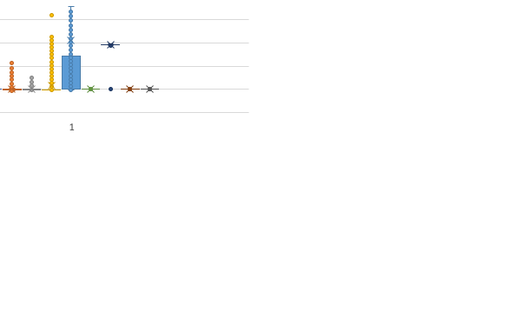
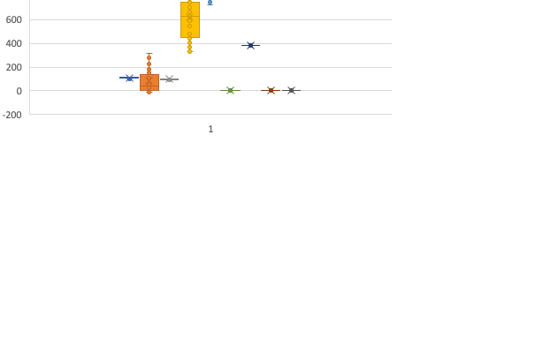
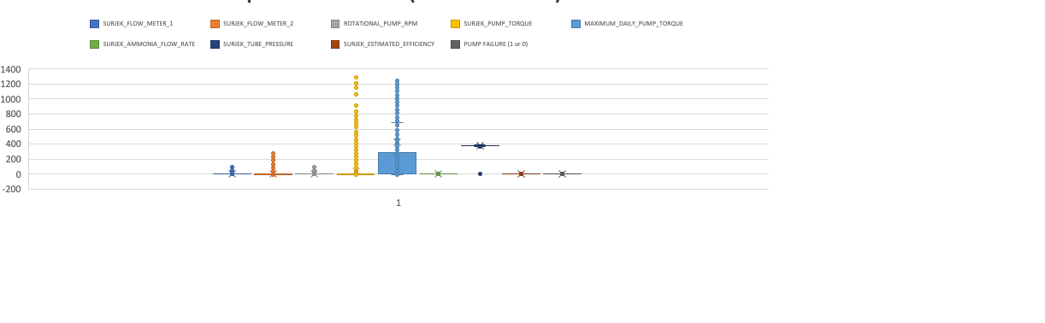
Which variables stand out when failure mode is on/off?
Pump Variable Statistical Analysis
Based on the pump failure mode, it looks like the Surjek pump torque and maximum daily pump torque, and the surjek flow meter are contributing most to pump failure.

Slide 3
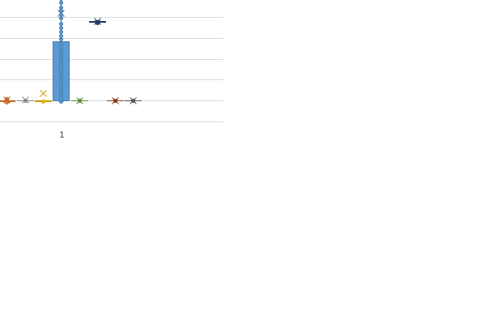
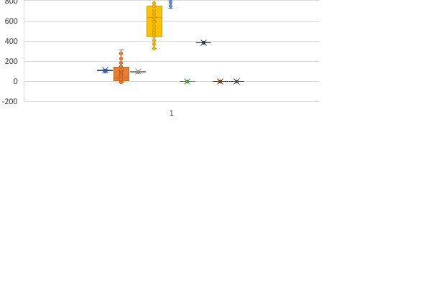
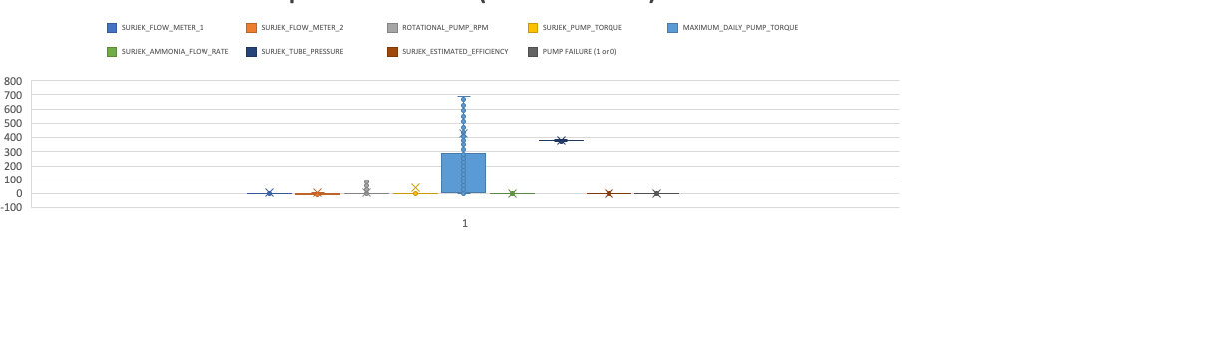
Which variables stand out when outliers are removed?
Pump Variable Statistical Analysis
The distribution of the data comprising failure mode on and off is being displayed.

Slide 4
Which variables are correlated with one another?
Pump Variable Statistical Analysis
 | SURJEK_FLOW_METER_1 | SURJEK_FLOW_METER_2 | ROTATIONAL_PUMP_RPM | SURJEK_PUMP_TORQUE | MAXIMUM_DAILY_PUMP_TORQUE | SURJEK_AMMONIA_FLOW_RATE | SURJEK_TUBE_PRESSURE | SURJEK_ESTIMATED_EFFICIENCY
SURJEK_FLOW_METER_1 | 1
SURJEK_FLOW_METER_2 | 0.663678959 | 1
ROTATIONAL_PUMP_RPM | 0.767183765 | 0.610088029 | 1
SURJEK_PUMP_TORQUE | 0.801862899 | 0.482356069 | 0.737259013 | 1
MAXIMUM_DAILY_PUMP_TORQUE | 0.048745198 | 0.171492115 | -0.021710541 | 0.042234106 | 1
SURJEK_AMMONIA_FLOW_RATE | #DIV/0! | #DIV/0! | #DIV/0! | #DIV/0! | #DIV/0! | 1
SURJEK_TUBE_PRESSURE | 0.044884429 | 0.054394867 | 0.055546647 | 0.05072557 | 0.15647208 | #DIV/0! | 1
SURJEK_ESTIMATED_EFFICIENCY | 0.122047042 | 0.038266541 | 0.043189483 | 0.101792494 | 0.119259192 | #DIV/0! | 0.108182543 | 1
SURJEK_FLOW_METER_1 and SURJEK_PUMP_TORQUE have a positive correlation. The same goes for ROTATIONAL_PUMP_RPM and SURJEK_FLOW_METER_2. Lastly, SURJEK_PUMP_TORQUE and ROTATIONAL_PUMP_RPM also have a strong correlation.

Slide 5
Which variables are closely related to pump failure?
Pump Variable Statistical Analysis
We can determine which values are closely correlated to pump failure based on the dark gray bars on the chart above. From descending order, we have MAXIMUM_DAILY_PUMP_TORQUE, followed by SURJEK_PUMP_TORQUE, SURJEK_FLOW_METER_2, and finally SURJEK_FLOW_METER_1. These correlations are also correct based on my linear regression equation y = x₁ * 0.00047 + x₂ * 0.0015 + x₃ * 0.0019 + x₄ * 0.000027 + x₅ * 0.0024 + x₆ * 0.00013 + x₇ * 0.0067 - 0.0071

Slide 6
Conclusion
1
List of Significant Variables Impacting Pump Failure
2
Recommendation
MAXIMUM_DAILY_PUMP_TORQUE
SURJEK_PUMP_TORQUE
SURJEK_FLOW_METER_2
SURJEK_FLOW_METER_1
Focus on MAXIMUM_DAILY_PUMP_TORQUE variables first because it is the value most correlated to the pump failure variable. Pay close attention to this variable and adjust pump torque accordingly.
Next, I would focus on the SURJEK_FLOW_METER_2 because it is closely correlated to MAXIMUM_DAILY_PUMP_TORQUE. I discrepancy in this value maybe responsible for the first.
Finally, we can hone in on SURJEK_PUMP_TORQUE & SURJEK_FLOW_METER_1.
Thank you for listening!

